Slide 1
MYPORTFOLIO
STUDENT NAME: AKSHAYASRI.R
REGISTER NO: 24BSAI207
NMID: 2DB3299C37E26EC8A9A4ACC39A8176
DEPARTMENT: B.Sc. ARTIFICIAL INTELLIGENCE AND MACHINE LEARNING
COLLEGE: SRI KRISHNA ADITHYA COLLEGE OF ARTS AND SCIENCE
UNIVERSITY: BHARATHIAR UNIVERSITY

Slide 2
MYPORTFOLIO

Slide 3


AGENDA
Problem Statement
Project Overview
End Users
Tools and Technologies
Portfolio design and Layout
Features and Functionality
Results and Screenshots
Conclusion
Github Link
3/21/2024 Annual Review

Slide 4

PROBLEM STATEMENT
In today’s digital world, having a personal portfolio is important for students and professionals to showcase their skills, projects, and contact details in an organized way. Many people face difficulties in presenting their work effectively to recruiters or others. To solve this, I have created “MyPortfolio”, a personal portfolio website built using HTML, CSS, and JavaScript. This website provides a clear navigation bar to move between sections smoothly. A hero section introducing myself. An about section with my profile and goals. A project section displaying my work. A contact section to share my details for communication.

Slide 5

PROJECT OVERVIEW
This project is a personal portfolio website called MyPortfolio, developed using HTML, CSS, and JavaScript. It is designed to provide a single place where I can showcase my academic details, skills, and achievements. The website is simple, user-friendly, and helps others easily navigate through my information..
About Me:
The portfolio includes an About Me section where I introduce myself with a short description, my profile picture, and course details. It also highlights my interests in learning new technologies and my career goal of getting placed in a good company and making my parents proud.

Slide 6
Projects:
The Projects section displays some of the works I have done, such as MyPortfolio Website, Book Recommendation Website, and Bird Webpage. Each project is shown in a card layout with hover effects, making it easy for users to view my work in an attractive way.
Skills:
The skills section highlights my abilities in Artificial Intelligence & Machine Learning, creativity, problem-solving, and web development basics. It also shows my interest in continuous learning and working on innovative projects to improve my knowledge.
Contact:
The Contact section contains my personal details such as name, email ID, and phone number. It is designed in a neat box style, making it easy for recruiters, teachers, or friends to get in touch with me. A send button is also added for interaction.
Main Idea:
The main idea of this project is to showcase my personal achievements, skills, and projects in a professional way. It acts as a digital resume where I can express my identity, display my work, and connect with people who may provide opportunities.

Slide 7

WHO ARE THE END USERS?
Recruiters / Employers – to view my skills, projects, and contact details.
Teachers / Mentors – to check my progress and work.
Friends / Peers – to explore my projects and get ideas.
General Audience – anyone interested in my portfolio.

Slide 8

TOOLS AND TECHNIQUES
HTML – used to build the basic structure and content of the portfolio website.
CSS – applied to design, style, and make the website look attractive and user-friendly.
JavaScript – added to provide interactivity, such as smooth scrolling and alert messages.
VS Code / CodePen – used as coding platforms to write, edit, and test the code.
Web Browser – used to run and view the portfolio after development.

Slide 9
POTFOLIO DESIGN AND LAYOUT
The website has a clean and simple design for easy navigation.
A navigation bar is placed at the top for quick access to sections.
The hero section highlights my introduction and goals.
The about section contains my profile picture and personal details.
The projects section displays my work in card style with hover effects.
The contact section provides my details inside a neat contact box.
A footer is included to complete the website with credits.
9

Slide 10
FEATURES AND FUNCTIONALITY
Responsive Design – adjusts well on desktop and mobile screens.
Navigation Bar – allows smooth scrolling between sections.
Hero Section – gives a quick introduction with a call-to-action button.
About Section – shows profile picture, course, and career goal.
Projects Section – displays project cards with hover effects.
Contact Section – provides personal details with a send button.
Interactive JavaScript – smooth scrolling and alert message on form submission.
Footer – contains credits and year information.

Slide 11
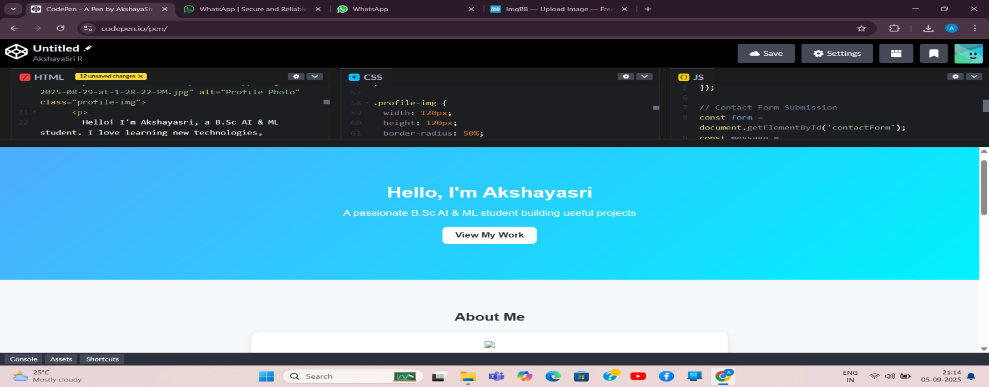

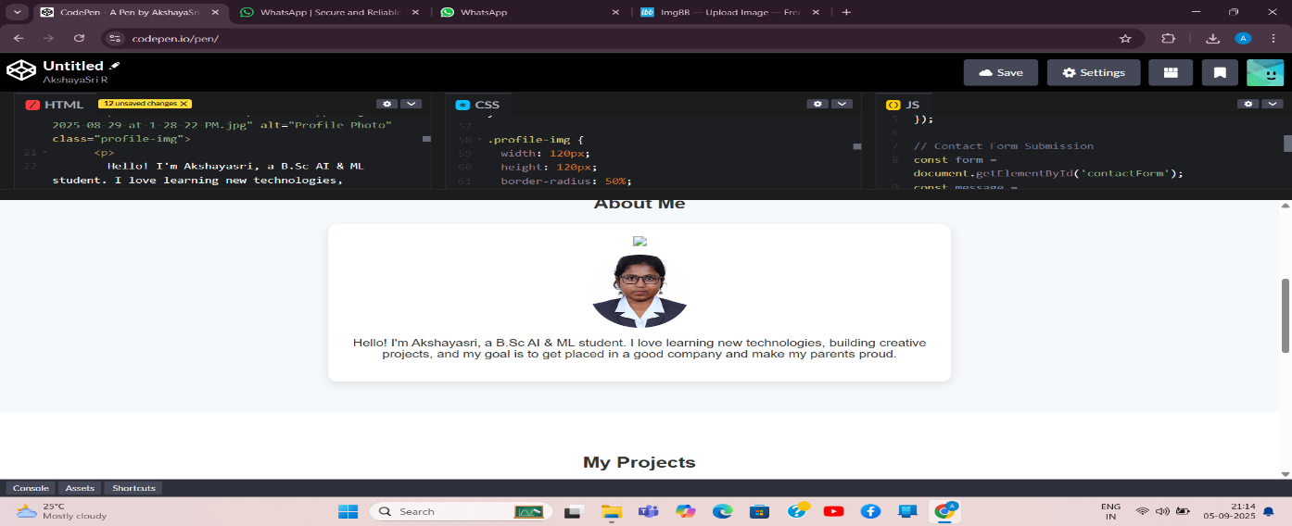
RESULTS AND SCREENSHOTS
3/21/2024 Annual Review
11

Slide 12
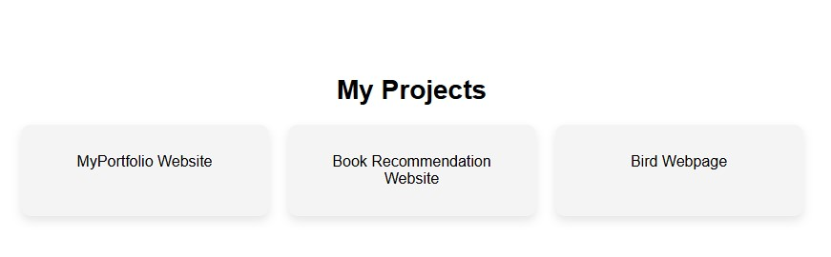
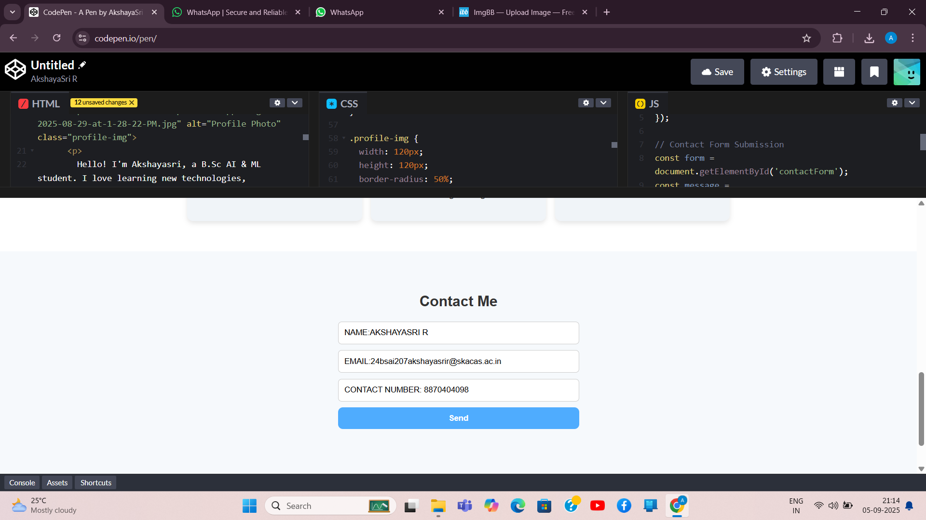

Slide 13
CONCLUSION
Highlights of the Project:
Developed a personal portfolio website using HTML, CSS, and JavaScript.
Designed with a modern and clean layout that is easy to navigate.
Includes separate sections like Home, About Me, Projects, Skills, and Contact.
Added profile picture and personal details to introduce myself clearly.
Showcased my projects with interactive cards and hover effects.
Implemented smooth scrolling and alert messages using JavaScript.
Responsive design ensures the website looks good on different devices.
Completed as a practical learning project to improve my web development skills.
13

Slide 14
Final Summary:
Designed and developed a personal portfolio website using HTML, CSS, and JavaScript.
Showcased my introduction, projects, skills, and contact details in one place.
Created a clean and user-friendly layout with smooth navigation.
Improved my web development skills and hands-on experience.
Built confidence to work on future creative and technical projects.

Slide 15
Benefits to Society:
Helps recruiters and employers quickly view my skills, projects, and contact details.
Provides a digital resume, reducing the need for printed resumes and saving paper.
Acts as an inspiration for other students to create their own portfolios and showcase their talents.
Encourages the use of technology for self-presentation in a professional way.
Makes it easier for teachers and mentors to track students’ growth and achievements.
Promotes digital awareness, motivating others to build an online presence.
Can serve as a sample project for beginners who want to learn web development.

